Slide 1
Algorithmic Thinking & Debugging
- By
Hemlata Kohin

Slide 2
What is an Algorithm?
Steps used to solve a problem
Problem must be
–Well defined
–Fully understood by the programmer
Steps must be
–Ordered
–Unambiguous
–Complete

Slide 3
Algorithmic Thinking
Algorithms are an ordered set of clear steps that fully describes a process
Examples from real life?
–Recipes
–Driving directions
–Instruction manual

Slide 4
Developing an Algorithm

Slide 5
Program Development
Understand the problem
Represent your solution (your algorithm)
– Pseudocode
– Flowchart
Implement the algorithm in a program
Test and debug your program

Slide 6
Step 1: Understanding the Problem
Input
–What information or data are you given?
Process
–What must you do with the information/data?
–This is your algorithm!
Output
–What are your deliverables?

Slide 7
Step 2: Represent the Algorithm
Can be done with flowchart or pseudocode
Flowchart
–Symbols convey different types of actions
Pseudocode
–A cross between code and plain English

Slide 8
Steps 3 and 4: Implementation and Testing/Debugging
Implementing and testing/debugging your program are two steps that go hand in hand
After implementing, you must test it
After discovering errors, you must find them
–Once found, you must fix them
–Once found and fixed, you must test again

Slide 9
Development Example: Weekly Pay
Create a program to calculate the weekly pay of an hourly employee
–What is the input, process, and output?
• Input: pay rate and number of hours
• Process: multiply pay rate by number of hours
• Output: weekly pay

Slide 10
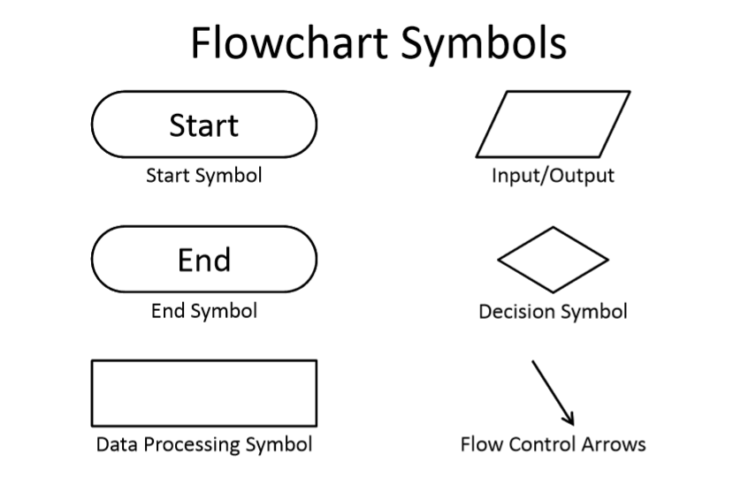

Slide 11
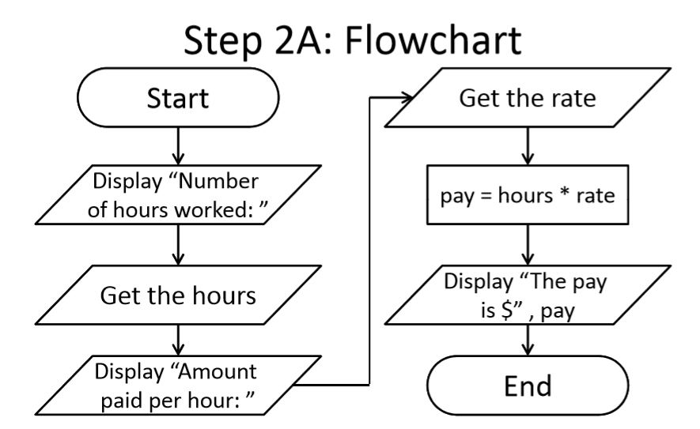

Slide 12
Step 2B: Pseudocode
Start with a plain English description, then…
1.Display "Number of hours worked:
2.Get the hours
3.Display "Amount paid per hour: “
4.Get the rate
5.Compute pay = hours * rate
6.Display "The pay is $" , pay

Slide 13
Algorithms and Language
Notice that developing the algorithm didn’t involve any Python at all
–Only pseudocode or a flowchart was needed
–An algorithm can be coded up in any language

Slide 14
Debugging

Slide 15

Errors (“Bugs”)
Two main classifications of errors
Syntax errors
–Prevent Python from understanding what to do
Logical errors
–Cause the program to run incorrectly, or to not do what you want

Slide 16
Syntax Errors
“Syntax” is the set of rules followed by a computer programming language
–Similar to grammar and spelling in English
Examples of Python’s syntax rules:
–Keywords must be spelled correctly True and False, not Ture or
Flase or Truu
–Quotes and parentheses must be closed in order:
("open and close")

Slide 17
Syntax Error Examples
Find the syntax errors in each line of code below:
1) prnit("Hello")
2) print("What"s up?")
3) print("Aloha!)
4) print("Good Monring")

Slide 18
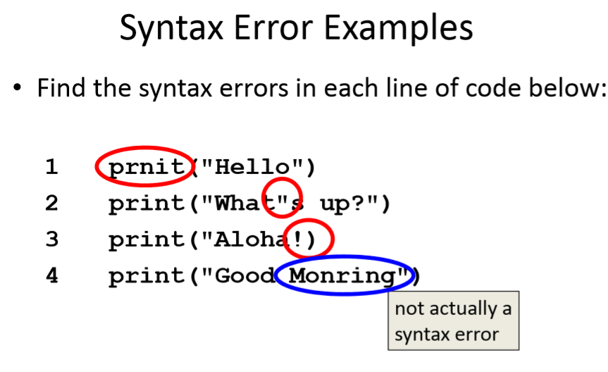

Slide 19
Logical Errors
Logical errors don’t bother Python at all… they only bother you!
Examples of logical errors:
–Using the wrong value for something
currentYear = 2013
–Doing steps in the wrong order
• “Place pan in the oven. Preheat oven to 350. Pour batter into pan, spreading evenly.”

Slide 20
Comments in Debugging
Comments are often used to convey what your program is doing
–If there is a bug, however, your code may not actually be
accomplishing that task
Comments are very useful when debugging, because they separate intent from actuality
–“Is your code working?” and “Is your code doing what it’s supposed
to do?” are very different questions

Slide 21
How are comments made in Python
#This is a single line comment
‘’’ This is
a multiline
comment ’’’

Slide 22
HW 3
Write the Pseudocode and draw a flowchart for calculating percentage.
Below is the formula for calculating the percentage
Percentage= marks obtained/ total marks * 100
Do this on your notebook and submit the next day.

Slide 23
Any Questions?

